Slide 1
SRI KRISHNS ARTS AND SCIENCE COLLEGE Coimbatore-641008
Department of IT and Cognitive Systems
Miniproject
Review-II
Date-Sep 9th 2024
Guide Name: Mrs .Medhunhashini DR Register Number: 23MIT043
Student Name: RAJA SHREE.G

Slide 2
FRONTEND TECHNOLOGIES AND MATERIALS USED
1.Languages Used:
HTML: Structure and content of the web pages, including sections like header, navigation, and forms.
CSS: Styling and layout, applied via an external stylesheet (style.css). This includes the design of elements such as buttons, text fields, and icons.
JavaScript: Dynamic functionality, including interactive elements such as updating the cart, removing items, and redirecting users to the payment page.
2.Materials and Components:
Buttons:
Standard buttons styled using CSS classes like .normal.
Examples: “Apply”, “Proceed to checkout”, “Submit”, and “Sign Up” buttons.

Slide 3
Icons:
Font Awesome: For adding icons such as shopping bags, social media icons, and action buttons. Included via external CDN and local path.
Icons used: Shopping bag, Facebook, Twitter, Instagram, Pinterest, YouTube, etc.
Text Fields and Forms:
Input Fields: For user data entry like name, email, subject, and message. Examples: <input type="text" placeholder="Your Name">.
Text Areas: For longer text input, such as messages in contact forms. Example: <textarea placeholder="Your Message"></textarea>.
Tables:
Used for displaying cart items, including columns for remove actions, product images, names, prices, quantities, and subtotals.
Example: <table>...</table> structure with <thead> and <tbody> sections.

Slide 4
Images:
Logos, feature icons, and other visual elements displayed using the <img> tag.
Example: <img src="img/logo_new.png" alt="Logo">.
Navigation Bar:
Menu: Horizontal list of links for site navigation, styled with CSS.
Example: <ul id="navbar">...</ul> with list items <li> for each navigation option.
Sections and Layouts:
Header: Contains logo and navigation links.
Page Header: Section with a title and description.
Feature Section: Showcases key services with icons.
Footer: Provides contact information, social media links, and additional site links.
3.External Resources:
Font Awesome: For icons, loaded via CDN and potentially a local path.
Google Maps Embed: For displaying location in the contact section.

Slide 5
DOMAINS
Login page :
UI Design: Clean and simple with HTML, CSS, and Font Awesome icons.
Form Fields: Email and password with "Remember me" option and "Forgot Password" link.
API Request: POST request to http://localhost:8080/api/v1/user/login using JavaScript's Fetch API, sending credentials in JSON format.
Login Outcome: Redirects to home page on success; displays error message on failure.
Additional Link: Directs to the registration page for new users.
Register page:
Collects: Full Name, Username, Phone Number, Email, Password, and Gender.
Password is validated and confirmed before submission.
Sends data via an asynchronous POST request using Fetch API to the backend API (http://localhost:8080/api/v1/user/save) in JSON format.

Slide 6
On success: redirects to login page with a success alert.
On failure: displays an error message.
UI includes gender selection (radio buttons) and a link to navigate to the login page for existing users.
Home Page:
Header Section: Includes navigation links like "Home," "Shop," "Blog," "About," "Contact," and a cart icon for easy access to products.
Featured Products: Displays product images with descriptions, ratings, prices, and an option to add them to the cart.
New Arrivals: Presents the latest products with images, details, and cart options.
Banners: Showcases seasonal promotions and new product collections.
Newsletter Section: Encourages users to sign up for email updates.
Footer: Contains contact information, social media icons, app download links, and navigation for account management and company policies.

Slide 7
Shop Page:
Header: Navigation menu with links to key pages (Home, Shop, Blog, etc.) and a logo.
Page Header: Promotional banner with discounts.
Product Display: Grid of products with images, descriptions, star ratings, and prices.
Pagination: Navigation for multiple product pages.
Newsletter Signup: Form for email updates.
Footer: Contact info, social media links, app promotion, and payment options.
Blog Page:
Header: Navigation menu with links to Home, Shop, Blog (active), and other key pages.
Page Header: Banner with the hashtag #readmore and a call to read case studies.
Blog Posts:
Displays a list of blog entries with images, titles, excerpts, and "Continue Reading" links.
Topics include fashion trends and style tips.
Footer: Includes contact information, social media links, app promotion, and additional site links.

Slide 8
About Page:
Header: Navigation menu with links to Home, Shop, Blog, About (active), Contact, Cart, and Login.
Page Header: Banner with the hashtag #KnowUs and a brief description.
About Section:
Introduction: Information about the company, including its mission and values.
Marquee: Scrolling text highlighting the company’s offerings.
Footer: Contact information, social media links, app installation options, and additional site links.
Cart Page :
Header: Navigation menu with links to key pages including Cart (active).
Page Header: Banner with the hashtag #let's_talk and an invitation to leave a message.
Cart Table:
Displays items in the cart with options to remove or adjust quantities.
Shows product image, name, price, quantity, and subtotal for each item.
Includes a message for when the cart is empty.

Slide 9
Cart Totals:
Shows cart subtotal, shipping (free), and total amount.
Option to apply a coupon.
Button to proceed to checkout.
Footer: Contact details, social media links, app promotion, and additional site links.
Contact Page:
Header: Navigation menu with links to Home, Shop, Blog, About, Contact (active), Cart, and Login.
Contact Details:
Head Office: Address, email, phone number, and office hours.
Map: Embedded Google Map showing the office location.
Team Contacts:
Profiles of key team members with their contact details and roles.
Footer: Contact information, social media links, app installation options, and additional site links.

Slide 10
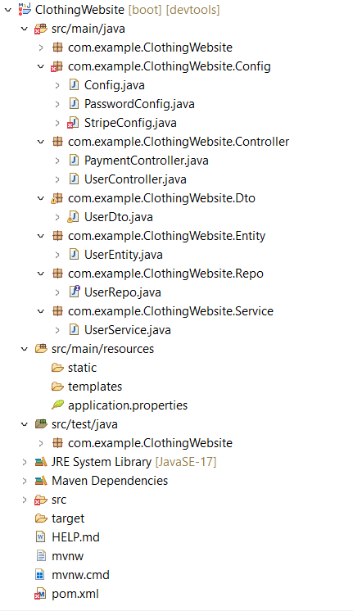
BACKEND

Slide 11
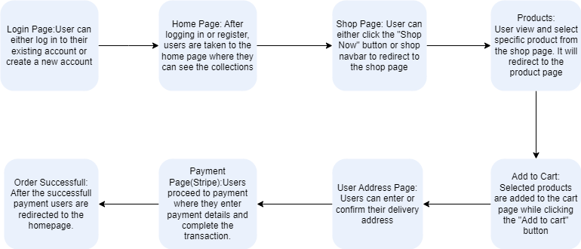
FLOW CHART

Slide 12
THANK YOU

